Slide 1

SRM INSTITUTE OF SCIENCE AND TECHNOLOGY
SCHOOL OF COMPUTING
DEPARTMENT OF COMPUTING TECHNOLOGIES
18CSP109L - MAJOR PROJECT
Weapon Detection using Yolo Model (Deep Learning)
Batch ID: B054
RA1911003010129
Carlin Fernandes
RA1911003010497
Adit Mahajan
Guide name:
Dr . A. Pandian

Slide 2
Abstract
Object recognition is one of the most basic and complex problems in computer vision, which seeks to locate object instances from the enormous categories of already defined and readily available natural images. The object detection method aims to recognize all the objects or entities in the given picture and determine the categories and position information to achieve machine vision understanding. In this project, we build a system that is able to detect weapons in real-time surveillance using YOLO algorithm, it’s a new state-of-the-art for real-time object detectors released. The aim of this project is to investigate the effect of training YOLO with various classes “weapons” and “Shotgun” on detecting weapons in video streams/images.

Slide 3
Introduction
We humans easily identify the objects from the images in real-time, but in the case of algorithms, it's a bit complicated before CNN. CNN was brought by Alex net in 2012, and after that, most things have changed from that time. Many enhancements have happened, and thus we can say that today's machines are faster and more accurate than humans. Security has always been a main concern in every domain and due to the rise in crime rate in major big cities and lonely areas. Abnormal detection and monitoring have major applications of computer vision to counter various problems. Due to the growing demand in protection of safety, security and personal so deployment of surveillance in video systems can recognize the events happening and plays and important role in intelligence monitoring.

Slide 4
Motivation
The reason and motivation behind this work is to detect various weapons in real time, thus reducing the incidents. These incidents can be controlled using an early alarm system by alerting the operators and concerned authorities so that action can be taken immediately.
In most current surveillance systems, monitoring depends on the existence of a human element. This makes monitoring a very challenging task. In addition, it is labor-intensive and prone to errors. These traditional systems have many problems such as weak security, low intelligence, high cost, and poor stability. Most of these systems are based on human operators. It is difficult for these operators to watch and analyze all the dangerous situations, especially with the long observation periods and many cameras. So, it is necessary to review our surveillance system again with the knowledge of new technology. we should prepare and prevent the dangers and not repair and repent the wounds, One way to reduce this kind of violence is prevention via early detection so that the security agents or policemen can act. One innovative solution to this problem is to equip surveillance or control cameras with an accurate automatic weapon detection alert system.

Slide 5
Innovation idea of the project
Security is always a main concern in every domain, due to a rise in crime rate in a crowded event or suspicious lonely areas. Abnormal detection and monitoring have major applications of computer vision to tackle various problems.
Due to growing demand in the protection of safety, security and personal properties, needs and deployment of video surveillance systems can recognize and interpret the scene and anomaly events play a vital role in intelligence monitoring.

Slide 6
Objectives of the project
An automatic weapon detection system can provide the early detection of potentially violent situations that is of paramount importance for citizens security. One way to prevent these situations is by detecting the presence of dangerous objects such as handguns in surveillance videos.
In order to train the object detector we need to supervise the learning with box annotations. We draw a box around each object that we want the detector to see and label it with a class that the detector would predict. There are various tools available to do the labelling eg: LabelImg. The YOLO model is then installed for object detection and the images are then inputted for the detection and the output is produced.

Slide 7
Challenges and limitations in existing systems
The cost of maintenance and installation would be high and also keeping security personnel 24x7 will make them fatigue.
One of the challenges in this system is detecting the objects that are small size. This is because of the design of the anchor boxes.
A challenge for devices with limited resources as due to the models high memory requirements. To run the systems larger amount of memory is needed.

Slide 8
Scope and application of the project
An Object detection is a computer vision technique that allows us to identify and locate objects in an image or video. With this kind of identification and localization, object detection can be used to count objects in a scene and determine and track their precise locations, all while accurately labeling them.
YOLO, an acronym for 'You only look once,' is an open-source software tool utilized for its efficient capability of detecting objects in a given image in real time. The YOLOv3 algorithm uses Darknet to detect objects in an image.
Today's concealed weapons detection systems improve safety by speeding up the screening process, reducing officer fatigue, integrating with other security systems.

Slide 9
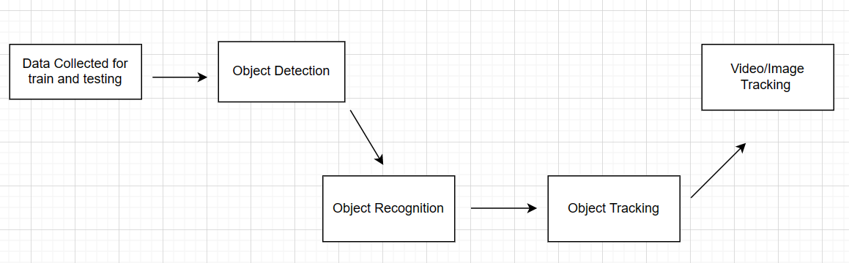
Architecture Diagram

Slide 10
Proposed Modules and their Algorithm Description
The proposed system would be first the images are collected for training purposes and specific images needed to be collected to improve the final models accuracy.
In order to train the object detector we need to supervise the learning with box annotations. We draw a box around each object that we want the detector to see and label it with a class that the detector would predict. There are various tools available to do the labelling eg: LabelImg or we can collect the dataset from Open Dataset which has thousands of Images. The YOLO model is then installed for object detection and the images are then inputted for the detection and the output is produced.
In this project the neural network is trained using classification from a opensource dataset and our own dataset which for each weapon is created and using this above dataset to train the weapons detector by fine tuning the trained model.

Slide 11
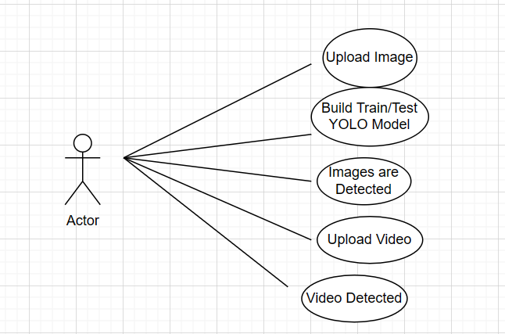
UML Diagram

Slide 12
Implementation
To implement the trained YOLOV3 model the requirements are from the library of the model that is the available config file present in the YOLOV3 model which tells in detail about the layers and other information like the number of filters that are present in each of the layers in the model, the learning rate of the model, classes present and the size of input of each of the layers and the channels. The yolov3.config file gives us a better understanding of the structure of the model by defining the number of batch sizes and whether the model should be trained and tested. With the help of the config file one can also edit the config file based on their requirements in training the model and by saving it as yolov3-custom.config as this file will serve as the custom configuration to the model that one could be training on.

Slide 13
Implementation
One can also go ahead and then collect the dataset which is pretrained like COCO Dataset or Alex Net and one could also use Open Images Datasets V7 that we have used in this project all of these datasets can be used for detection purposes. The Open Images Dataset V7 contains the dataset of millions of images that are interpreted with labels, bounding box and segmentation masks.
The dataset has a total of 16 million bounding boxes and over 600 classes of objects on a total of 1.9 million images making it one of the largest datasets with object annotations.
It does also give visual relationships that indicate that the object is of some certain relation or similar.
In the version 5 the segmentation masks were also added for 2.8 million of the objects and segmentation masks were also added for level of details

Slide 14
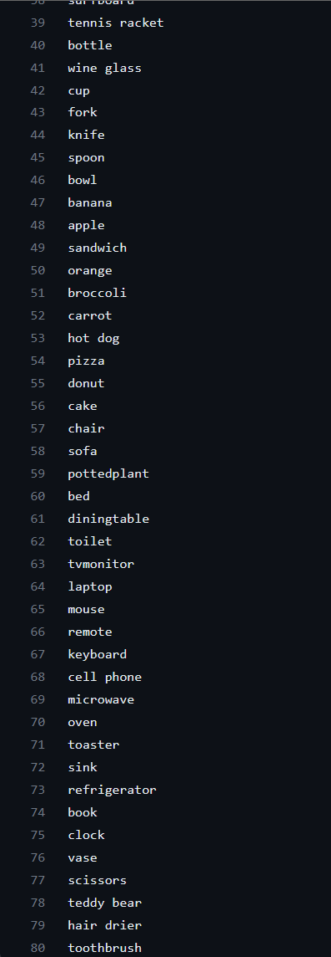
Implementation
These are 80 classes the YOLO model was already pre-trained on
In this model we have trained the neural network which was a very long process as it required thousands of images and a lot of computational power in graphics processing which took around 7+ hours to train the model. Training was required for the model as it used to detect custom objects which are not yet present or done on which it is trained or the objects that are detected under a certain class as when making just general predictions to which the class the certain object falls. To make the predictions to detect certain objects on which the model was trained for hours, a implantation can be done to get the network running.
To do that requires the yolo-v3.config file and also the weight file of the model that is pretrained. A pretrained weights file contains the mathematical relationships between neurons in adjacent layers of a neural network. These relationships, or weights, represent the influence of one neuron on another. When training a model from scratch, random values are initially assigned to these weights. During training, the values are optimized using a loss function and an optimization function to improve the network’s performance. When retraining the network, the weights of certain layers can be frozen based on the amount of available data and the specific purpose of the retraining.

Slide 15
Implementation
[net]
# Testing
batch=1
subdivisions=1
# Training
#height=batch=64
#subdivisions=16
width=416
416
channels=3
momentum=0.9
decay=0.0005
angle=0
saturation = 1.5
exposure = 1.5
hue=.1
learning_rate=0.001
burn_in=1000
max_batches = 4000
policy=steps
steps=3200,3600
scales=.1,.1
[convolutional]
batch_normalize=1
filters=32
size=3
stride=1
pad=1
activation=leaky

Slide 16
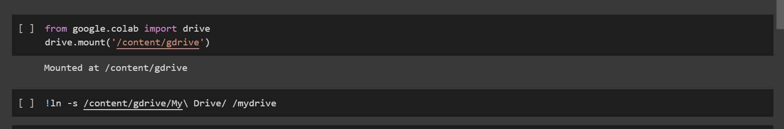
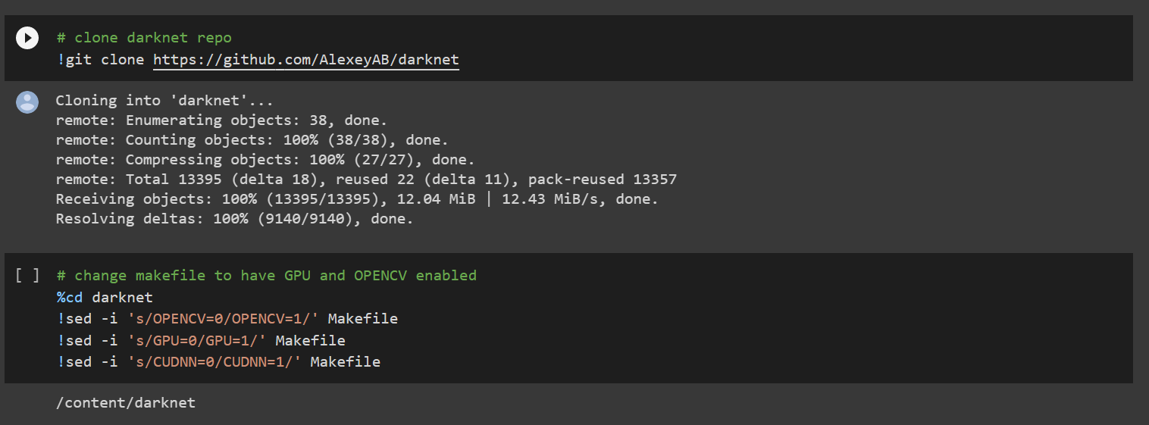
Screenshots

Slide 17
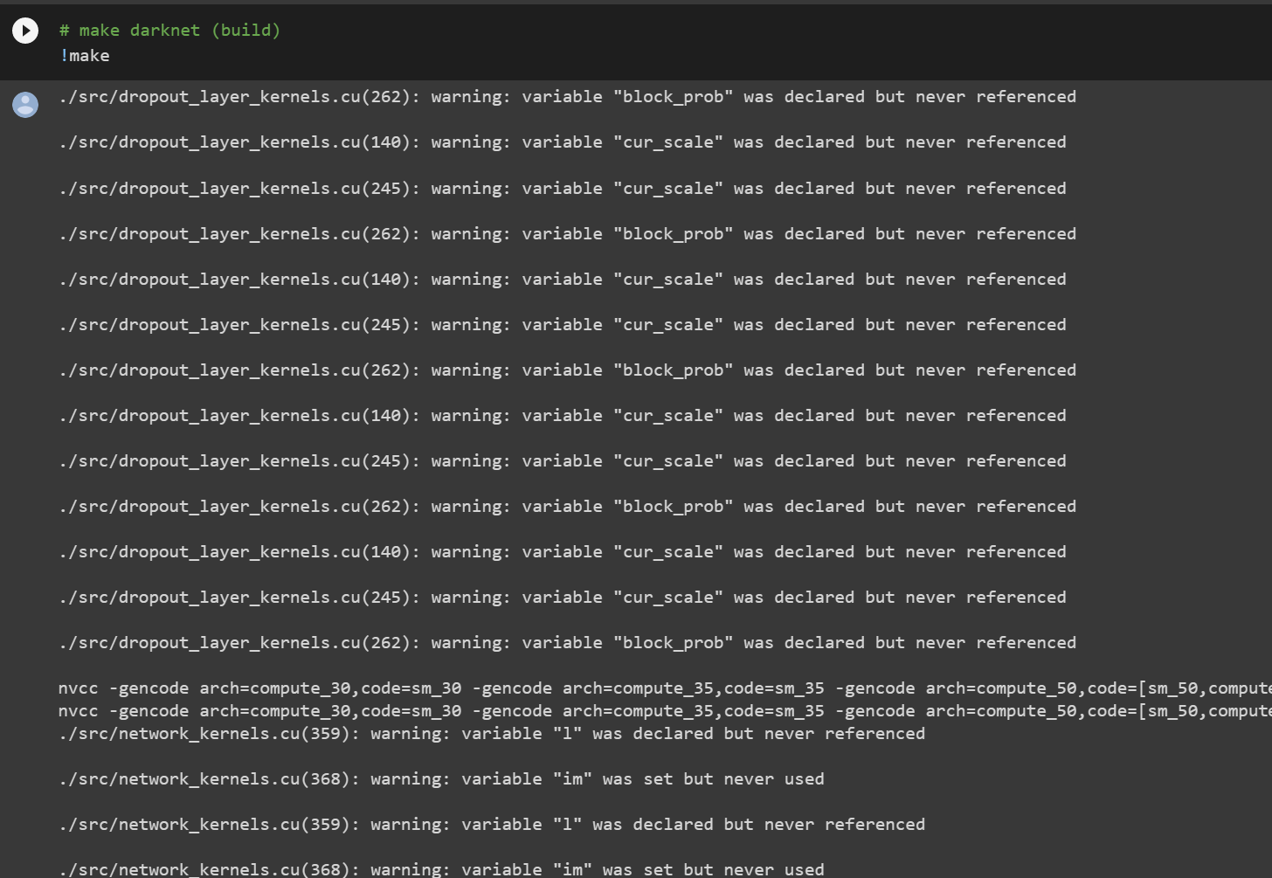
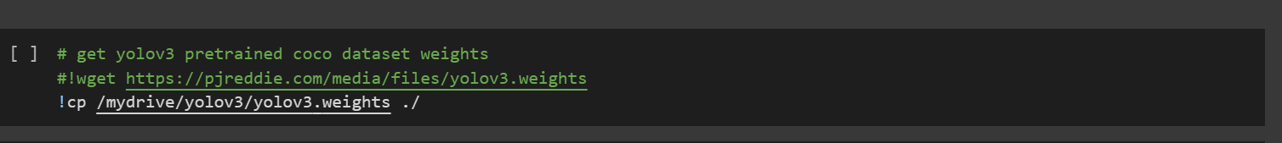

Slide 18
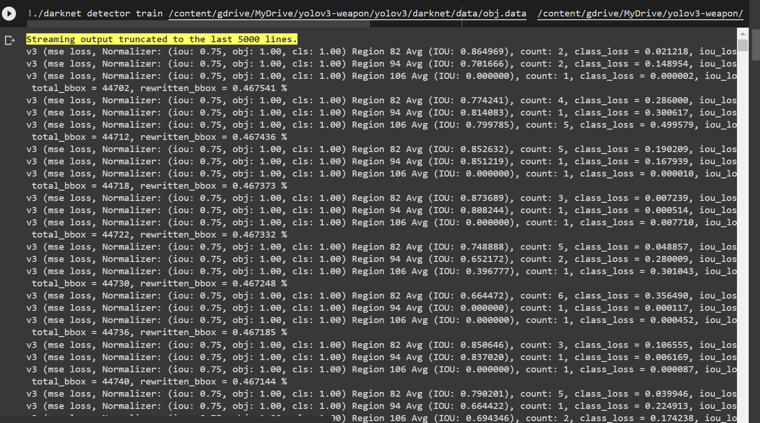
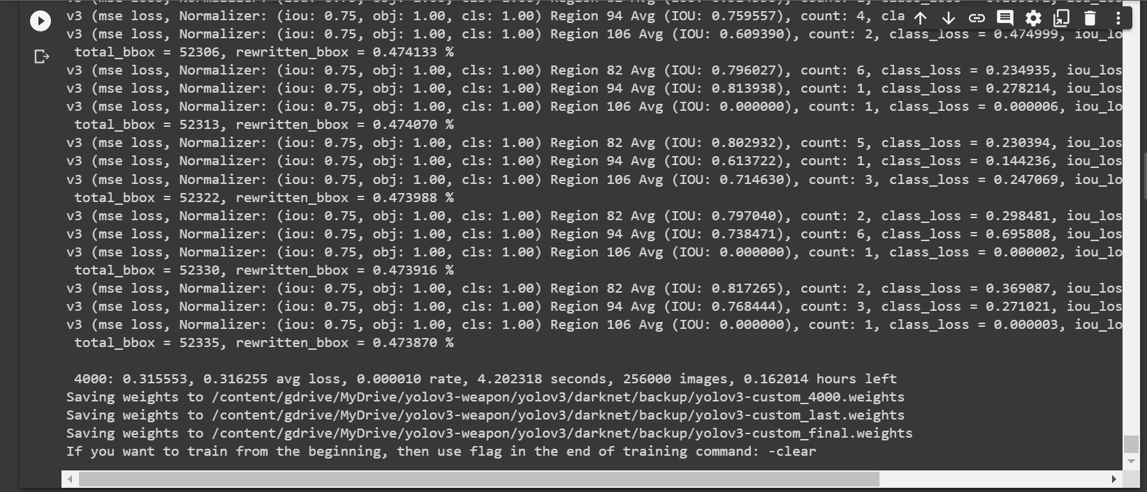

Slide 19
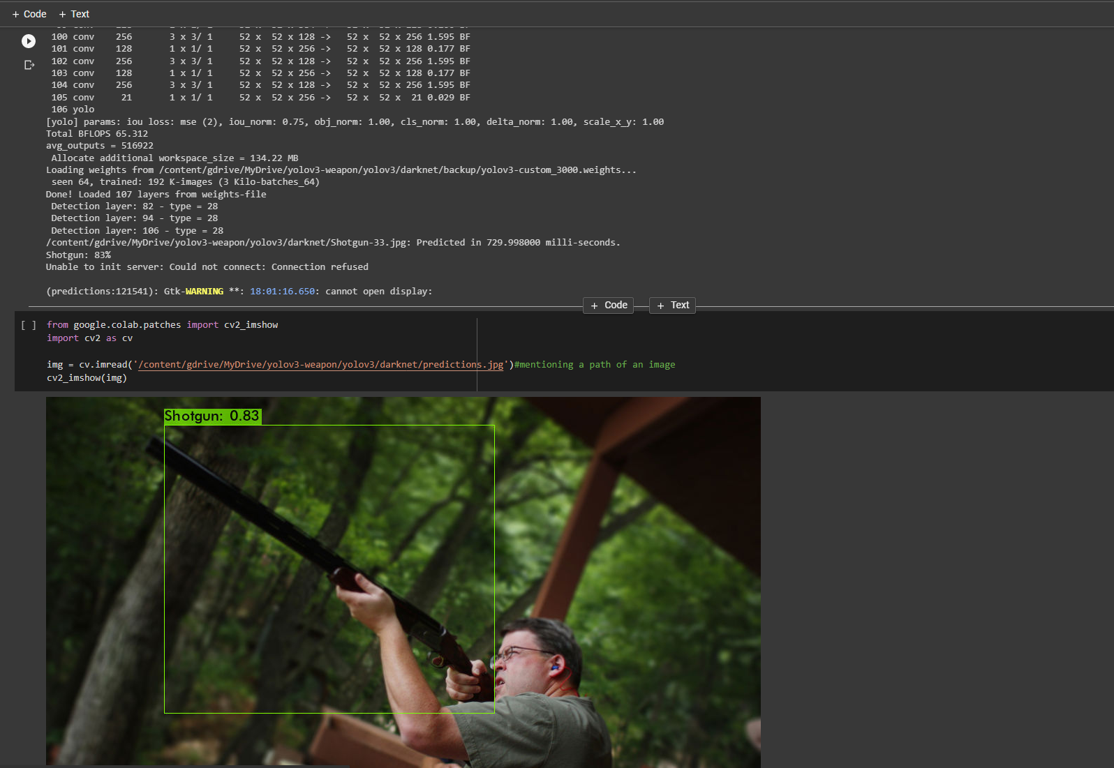

Slide 20
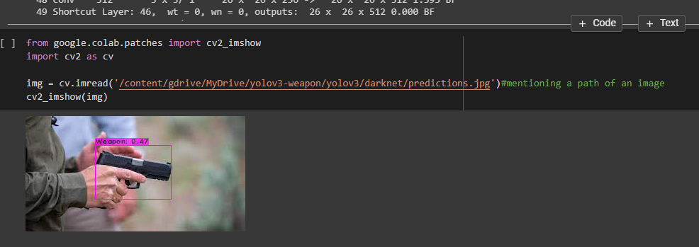
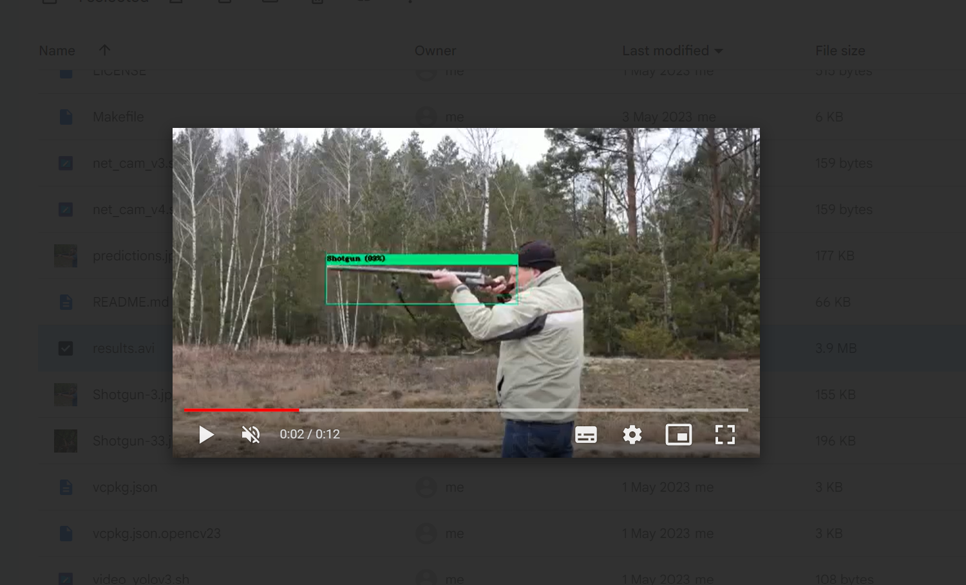
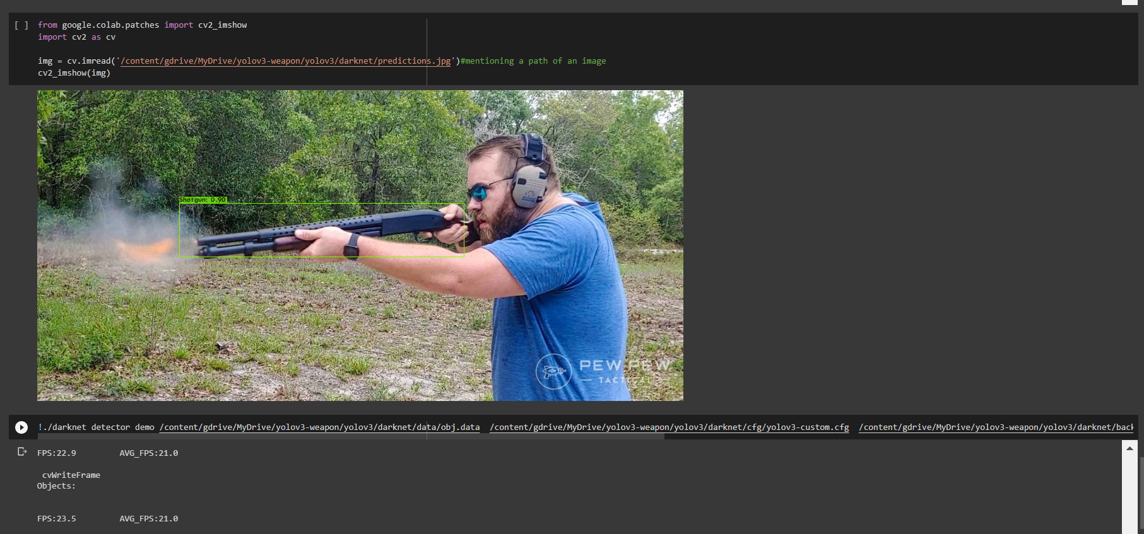
Outputs:

Slide 21

Proof of Publication

Slide 22
References
[1] Jimin Yu and Wei Zhang. Face Mask Wearing Detection Algorithm Based on Improved YOLO-v4 (2021), Sensors 2021, 21(9)
[2] Chien-Yao Wang, Alexey Bochkovskiy, HongYuan Mark Liao. Scaled-YOLOv4: Scaling Cross Stage Partial Network (2021), Proceedings of the IEEE/CVF Conference on Computer Vision and Pattern Recognition (CVPR), pp. 13029-13038
[3] A Bochkovskiy, CY Wang, HYM Liao. YOLOv4: Optimal Speed and Accuracy of Object Detection (2020), arXiv:2004.10934v1 [cs.CV];
[4] R. Phadnis, J. Mishra and S. Bendale. Objects Talk - Object Detection and Pattern Tracking Using TensorFlow (2018) - Second International Conference on Inventive Communication and Computational Technologies (ICICCT), 2018, pp. 1216-1219
[5] Wang Zhiqiang and Liu Jun. A Review of Object Detection Based on Convolutional Neural Network, Proceedings of the 36th Chinese Control Conference
[6] Nadia Jmour, SehlaZayen, AfefAbdelkrim. Convolutional Neural Networks for image classification.
[7] A. Castillo, S. Tabik, F. Perez, R. Olmos, and F. Herrera, ´ “Brightness guided preprocessing for automatic cold steel weapon detection in surveillance videos with deep learning,” Neurocomputing, vol. 330, pp. 151–161, 2019.
[8] G. L. Hung, M. S. B. Sahimi, H. Samma, T. A. Almohamad and B. Lahasan, “Faster R-CNN deep learning model for pedestrian detection from drone images,” SN Computer Science, vol. 1, no. 2, pp. 1–9, 2020.
[9] A. Egiazarov, V. Mavroeidis, F. M. Zennaro and K. Vishi, “Firearm detection and segmentation using an ensemble of semantic neural networks,” in European Intelligence and Security Informatics Conf., Norway, USA, pp. 70–77, 2020.
[10] M. Grega, A. Matiolanski, P. Guzik, and M. Leszczuk, “Automated detection of firearms and knives in a CCTV image,” Sensors, vol. 16, no. 1, p. 47, 2016.

Slide 23
Thank You!

